Slide 1
DÖ TÍM
Juhász Benedek László [C8B5CT]
Tumay Ádám [Z7MTDT]
Bálint Gergő [O78UXU]

Slide 2
Introduction, goal, motivation
In this project we explore the usage of transformer networks for medical image segmentation.
Testing various Unet & Transformer Network
Segmentation of the abdominal area on 3D CT images
Large bowel, small bowel, stomach
Helping doctors and other algorithms
eg: creating semantic masks for interesting areas
Usefulness measured with a special metric

Slide 3
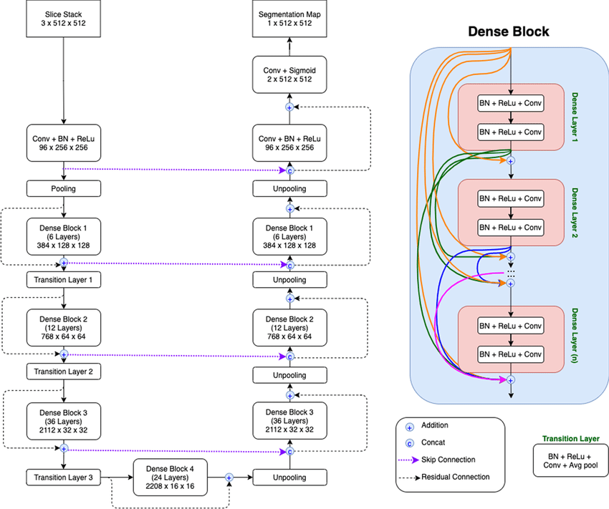
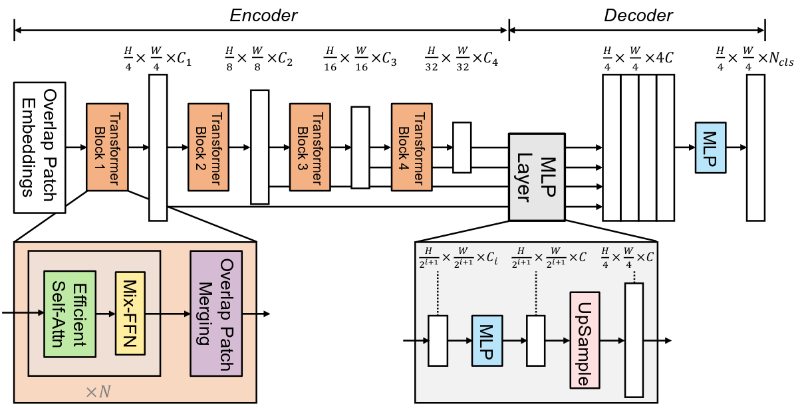
Architecture
Unet
DenseNet
FancyUNet
Vision Transformer
SegFormer (pretrained)

Slide 4
Implementation
Docker
Colab
Lightning
Tensorboard
Modes: checkpointing, architecture choice, gradio, testing

Slide 5
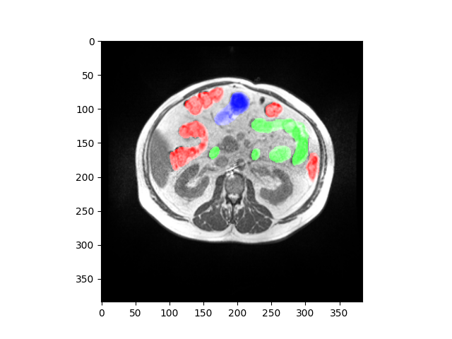
Dataset
CT
50 patients
Stomach, large intestine, small intestine
Filtering for empty slices
Normalization, resizing
Run-length-encoding
„Separation of patients”

Slide 6
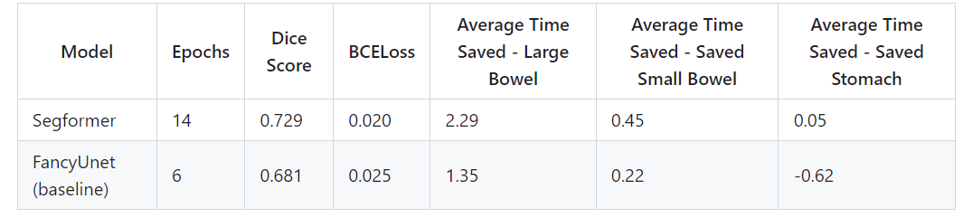
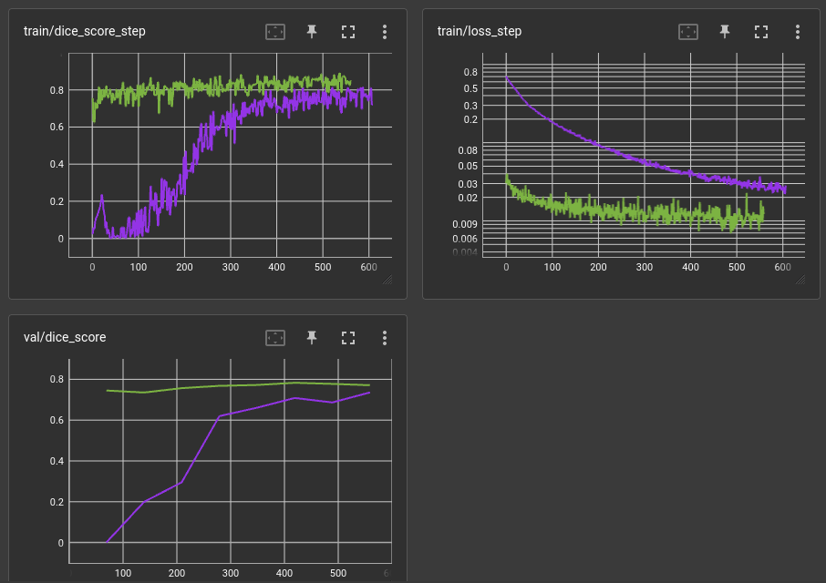
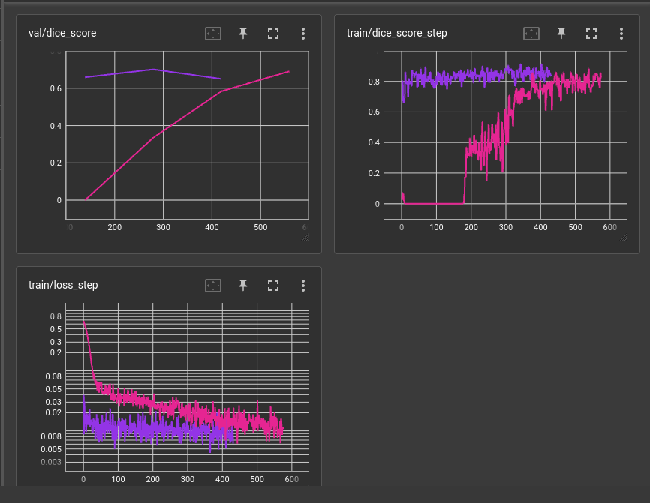
Training and evaluation
Segformer
FancyUNet

Slide 7
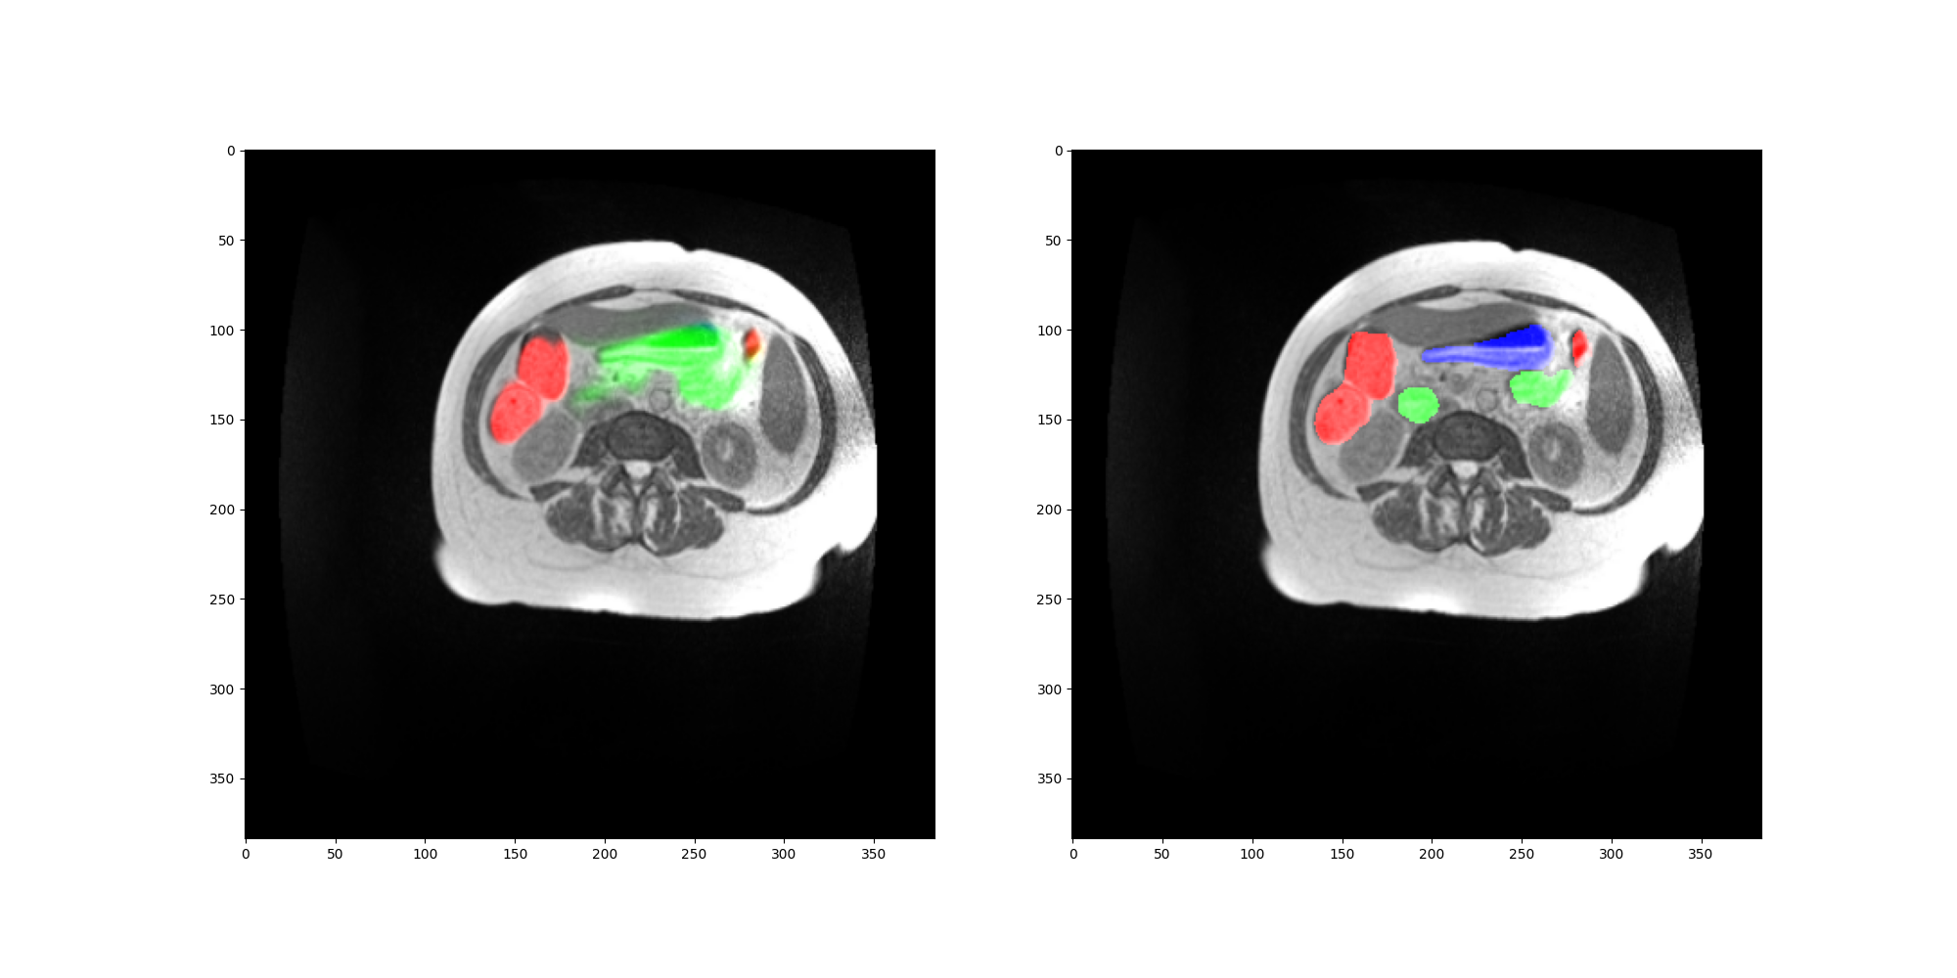
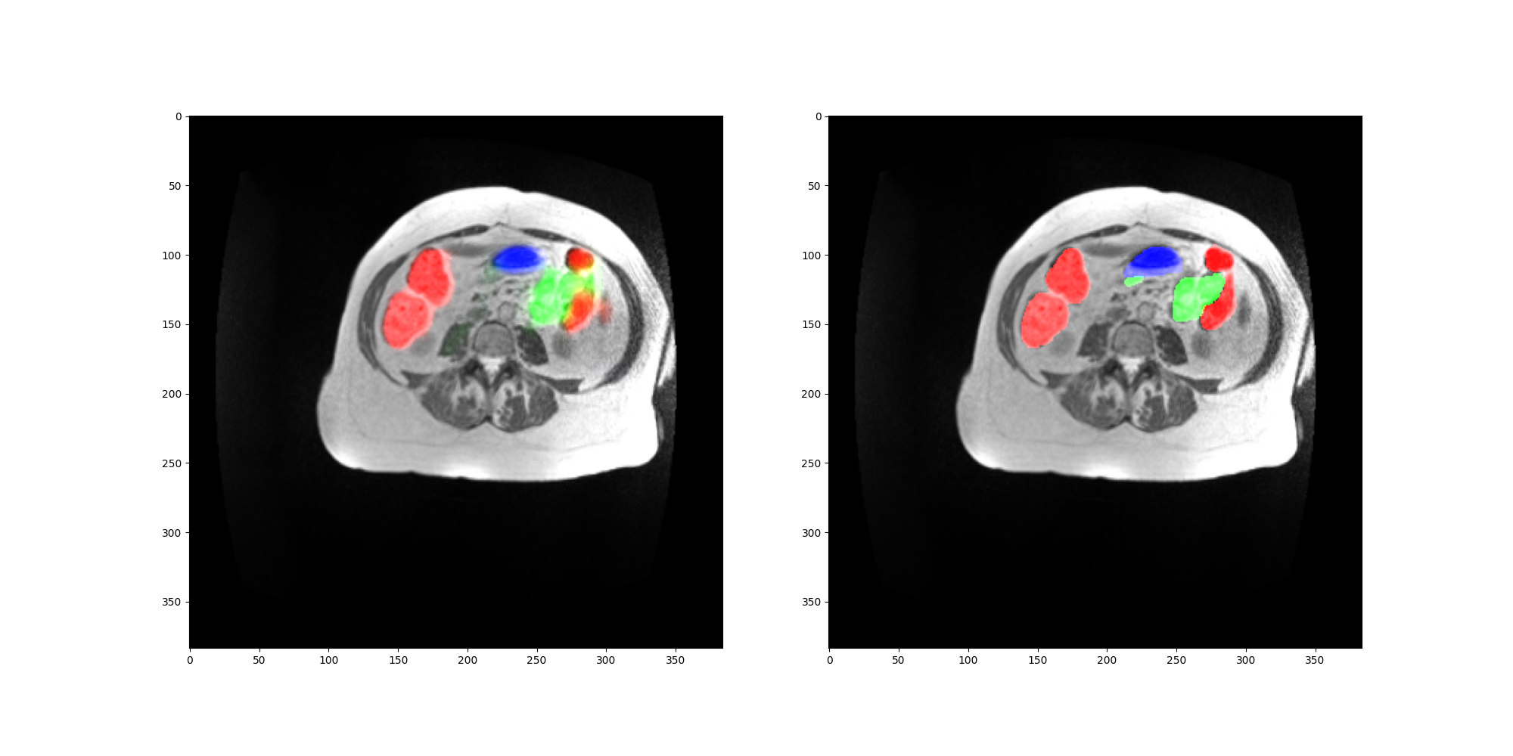
Results
SegFormer vs FancyUnet results
Ideas to improve
Larger dataset
Hyper-parameter optimizer
Model size
Resolution
Black-and-white
FancyUnet
SegFormer

Slide 8
DEMO

Slide 9
Summary
Different models compared
Results evaluated
Containerization
UI
Extra: colab-compatibilty
FancyUnet
SegFormer

